Slide 1

Title I Schoolwide
Annual Parent Orientation
Meeting
Oak Hill Elementary School
August 17, 2023
Presented by
Newton County School System
Office of Federal Programs

Slide 2
What Is Title I?
Title I is a part of the Federal Elementary and Secondary Education Act (ESEA), formally known as No Child Left Behind (2001). The Act provides financial assistance to state and local education agencies to meet the educational needs of children who may be at risk of failing the state’s performance standards.

Slide 3
Two Service Models
School-Wide: All students are eligible to be served
Targeted Assisted: Specific students only
WE ARE SCHOOLWIDE!

Slide 4

What is a Title I Schoolwide Program?

Slide 5
NCSS District Goals and Performance Objectives
Strategic Goal Area I: Student achievement and success
Improve student mastery of standards
Increase opportunities for students to demonstrate success beyond test scores
Increase graduation rate
Strategic Goal Area II: High-quality workforce
Improve recruitment process to identify and hire high-quality staff
Increase capacity of staff to deliver and support high-quality instruction
Improve retention rate of high-performing personnel
Strategic Goal Area III: Culture. Climate, & Communication
Provide equitable and inclusive learning and work environments at all levels of the district
Improve the quality of two-way communication with all stakeholders
Increase effective community partnerships
Strategic Goal Area IV: Organizational and operational effectiveness
Ensure a systemic culture of safety
Provide high-quality operational and instructional supports
Increase the quality and presence of professional learning communities to improve performance and ensure continuous improvement
Increase effectiveness utilizing performance development/management strategies

Slide 6
Title I School-Wide Goals
2023-24 School Goals
By the end of the school year, students in grades K-5 will increase their ELA/Reading scores by 5 points as measured by FastBridge.
By the end of the school year, students in grades K-5 will increase their math scores by 5 points as measured by FastBridge.

Slide 7
What programs/supports are in place to help my child?
Homeless and Foster Care Education Programs-The school district is required to provide uninterrupted educational services for students who are temporarily displaced (homeless) or living in foster care. Students may attend their school of origin or their home zoned school; based on what is in the best interest of the child.
Contact Person: Khiem Reed reed.khiem@newton.k12.ga.us
Migrant Education Program-The Migrant Education Program (MEP) is a federally funded program designed to support comprehensive educational programs for migrant children to help reduce the educational disruption and other problems that result from repeated moves.
Contact person: Mrs. Michelle Campbell - campbell.michelle@newton.k12.ga.us

Slide 8
Goals and Strategies

Slide 9
Support Areas
Parent and Family Engagment
Oak Hill had 177 parents respond to the Parent and Family Engagement Survey, 9 family members attend Literacy Night, and 16 family members attend math night.
Parents at Oak Hill are supporters, encouragers, monitors, advocates, decision makers, and collaborators in efforts to increase student achievement. Their involvement contributes to fewer discipline issues, better grades, and higher test scores.
Teachers have benefited from our Parent and Family Engagement program by building staff capacity and developing partnerships with families. These sessions have resulted in higher quality customer service, shared responsibility with parents, and the creation of a welcoming school culture.

Slide 10
Support Areas
Technology
Technology such as laptops, Chromebooks, Ipads, document cameras, interactive panels, and accompanying accessories have been used to enhance student learning by boosting engagement and addressing various learning styles. The technology was used in conjunction with software programs such as Istation Reading, Brainpop, Nearpod, ALEKS, and Seesaw to help increase student achievement and to help students master standards as evidenced by increased usage throughout the school year, software report data, and end of year report card data.

Slide 11
Support Areas
Professional Learning
Teachers participated in PLCs led by the Instructional Coach throughout the school year focused on such topics as virtual learning, the role of the PLC, developing success criteria, and fact fluency. Teachers also participated in various sessions provided by district leaders. New teachers participated in monthly professional learning by the BEST teacher leader. Professional learning sessions at Oak Hill have led to increased student achievement and student mastery of standards as demonstrated on the IOWA and end of year report card data.

Slide 12
Support Areas
Student Behavior and Attendance
Behavior recognition through the WOW program has increased time on-task for students, as well as contributed to a safe and orderly learning environment. Students at Oak Hill understand expectations and interact positively with their peers. Students also experience positive adult influences and a sense of belonging.
Student attendance at Oak Hill continues to decrease. We saw a significant increase in the number of students absent five or more days. Precautionary quarantine during our first full in-person school year, since the beginning of the pandemic, is a contributing factor. Students who attend school regularly demonstrate higher test scores, better grades, and overall increased student learning.

Slide 13
What Curriculum Does Our School Use?
Our school uses the state-mandated curriculum that allows us to follow the Georgia Standards of Excellence (GSE) for English/Language Arts, Reading, Math, Social Studies, and Science.

Slide 14
What Test Will My Child be Taking?
The Georgia Milestones Assessment System will consist of both End of Grade (EOG) and End of Course (EOC) measures. Students in grades 3-8 achievement will be measured using EOG tests in Language Arts, Mathematics, Science, Social Studies. High school students’ achievement will be measured using EOC tests in American Literature, Algebra 1, Biology, US History.
FastBridge Assessment - ?

Slide 15
The four achievement levels on Georgia Milestones are beginning learner, developing learner, proficient learner, and distinguished learner. The general meaning of each of the four levels is provided below:
The four achievement levels on Georgia Milestones are Beginning Learner, Developing Learner, Proficient Learner, and Distinguished Learner. The general meaning of each of the four levels is provided below:
Beginning Learners do not yet demonstrate proficiency in the knowledge and skills necessary at this grade level/course of learning, as specified in Georgia’s content standards. The students need substantial academic support to be prepared for the next grade level or course and to be on track for college and career readiness.
Developing Learners demonstrate partial proficiency in the knowledge and skills necessary at this grade level/course of learning, as specified in Georgia’s content standards. The students need additional academic support to ensure success in the next grade level or course and to be on track for college and career readiness.
Proficient Learners demonstrate proficiency in the knowledge and skills necessary at this grade level/course of learning, as specified in Georgia’s content standards. The students are prepared for the next grade level or course and are on track for college and career readiness.
Distinguished Learners demonstrate advanced proficiency in the knowledge and skills necessary at this grade level/course of learning, as specified in Georgia’s content standards. The students are well prepared for the next grade level or course and are well prepared for college and career readiness.

Slide 16
What is ACCESS for ELLs 2.0?
(Wida)
Our EL/Immigrant Students are tested using the Access Assessment
An English language proficiency assessment for students in Kindergarten through Grade 12
Given every year to students who are English language learners
Monitors the English language development of students
Notes:
Presenter note: add your test dates to the slide, if desired
ACCESS for ELLs 2.0 is an English language proficiency assessment for Grades K–12. The test is administered every year to help school districts monitor the English language development of students identified as English language learners.
ACCESS for ELLs 2.0 measures students’ abilities to understand and produce English used within school settings. The four sections of the test are Listening, Reading, Speaking, and Writing.
Every state sets a time frame for schools to administer ACCESS for ELLs 2.0. Schools schedule when students will take the four sections of the test during the testing time frame. In this school, students take the test starting in January.
Scores from ACCESS for ELLs 2.0 can be used in many ways. As parents or guardians, you can use the scores to advocate for their child. Teachers use the scores to plan instruction and assessments. Districts use the scores to evaluate their language support programs, to monitor student progress in acquiring English, and to determine if a student is eligible to exit an English language support program. Scores are also used to meet federal and state accountability requirements.

Slide 17
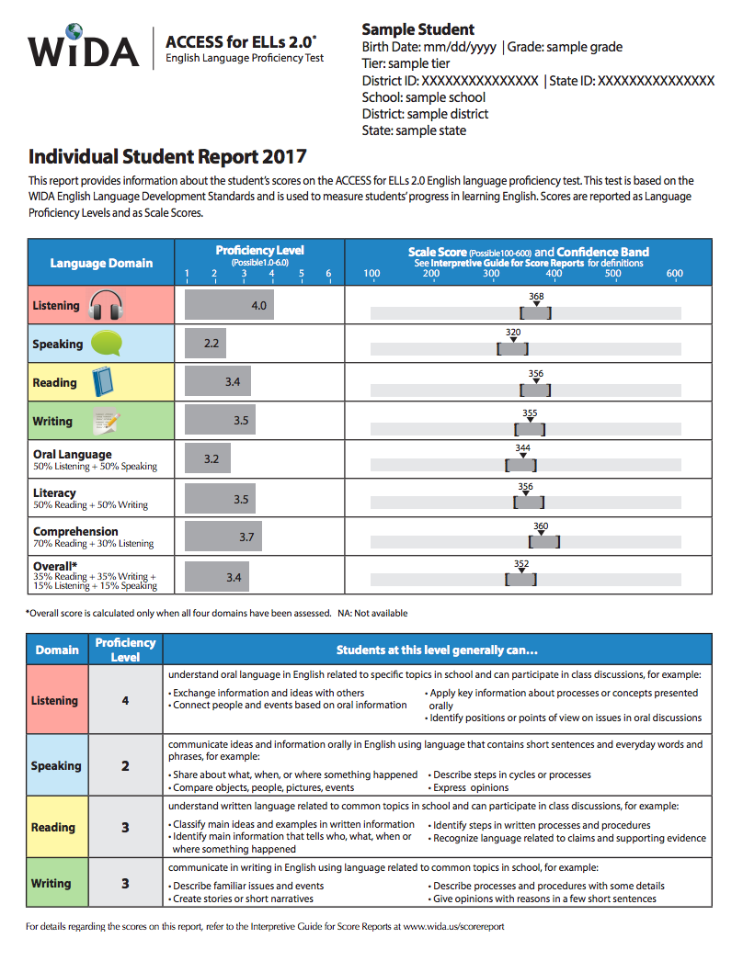
WiDA Individual Student Report
Score reports provide information on a student’s progress in the development of English language proficiency.
Proficiency level scores are reported from 1.0 (beginner) to 6.0 (advanced).
Notes:
The Individual Student Report shows the eight scores your child could receive on the test. If your child took all four sections of the test, he/she will receive all eight scores. NA, or not available, indicates no score was reported. There are four Language Domain scores and four Composite Scores.
Scale Scores are reported as numbers that range from 100 – 600, for example 356 or 220. These scores reflect your child’s grade level and difficulty level of the test items that he/she successfully completed. Scale scores are helpful to see the progress your child makes in English language development from year to year. The graph on the report shows your child’s Scale Score for each of the eight scores, and it also shows the Confidence Band for each of his/her Scale Scores.
Confidence Bands are the shaded area around each of your child’s Scale Scores. This shows the possible range for your child’s score with a 95% probability of accuracy. In other words, if your child took the same test repeatedly, there is a 95% chance that his/her scores would be within the shaded range.
We encourage families to look at all of the scores reported for their child. Here are some suggestions for how to interpret, or make sense of, your child’s scores:
• Look at the Language Domain scores. Look at his/her Proficiency Level scores for Listening, Speaking, Reading and Writing. Which scores are closer to 6.0? Which scores are closer to 1.0?
• Look at the Composite Scores. Look at his/her Proficiency Level scores for Oral Language, Literacy, Comprehension, and the Overall Score. Which scores are closer to 6.0? Which scores are closer to 1.0?

Slide 18
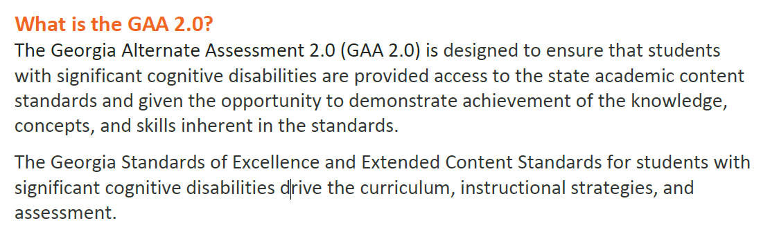
Georgia’s Alternative
Assessment 2.0 (GAA)
The GAA 2.0 will be administered to all eligible students in the following areas:
Grades K, 3-8, and 11 will be assessed in English Language Arts and Mathematics.
Grades 5, 8, and 11 will also be assessed in Science and S​​ocial Studies.
One-on-one assessment answered through the student’s mode of communication.
11 questioned ( 3 parts per question)
Notes:
Presenter note: add your test dates to the slide, if desired
ACCESS for ELLs 2.0 is an English language proficiency assessment for Grades K–12. The test is administered every year to help school districts monitor the English language development of students identified as English language learners.
ACCESS for ELLs 2.0 measures students’ abilities to understand and produce English used within school settings. The four sections of the test are Listening, Reading, Speaking, and Writing.
Every state sets a time frame for schools to administer ACCESS for ELLs 2.0. Schools schedule when students will take the four sections of the test during the testing time frame. In this school, students take the test starting in January.
Scores from ACCESS for ELLs 2.0 can be used in many ways. As parents or guardians, you can use the scores to advocate for their child. Teachers use the scores to plan instruction and assessments. Districts use the scores to evaluate their language support programs, to monitor student progress in acquiring English, and to determine if a student is eligible to exit an English language support program. Scores are also used to meet federal and state accountability requirements.

Slide 19
The Four Achievement Levels for the GAA 2.0.
Level 1: Students at this level demonstrate a limited understanding of the knowledge and skills specified in Georgia’s alternate academic content standards. They are actively working with adapted grade-level content that focuses on essential knowledge and skills and may need substantial academic support as they transition to the next grade/course, inclusive postsecondary education, or competitive integrated employment.
Level 2: Students at this level demonstrate a partial understanding of the knowledge and skills specified in Georgia’s alternate academic content standards. They are actively working with adapted grade-level content that focuses on essential knowledge and skills and may need frequent academic support as they transition to the next grade/course, inclusive postsecondary education, or competitive integrated employment.
Level 3: Students at this level demonstrate an adequate understanding of the knowledge and skills specified in Georgia’s alternate academic content standards. They are actively working with adapted grade-level content that focuses on essential knowledge and skills and may need occasional academic support as they transition to the next grade/course, inclusive postsecondary education, or competitive integrated employment.
Level 4: Students at this level demonstrate a thorough understanding of the knowledge and skills specified in Georgia’s alternate academic content standards. They are actively working with adapted grade-level content that focuses on essential knowledge and skills and may need limited academic support as they transition to the next grade/course, inclusive postsecondary education, or competitive integrated employment.

Slide 20
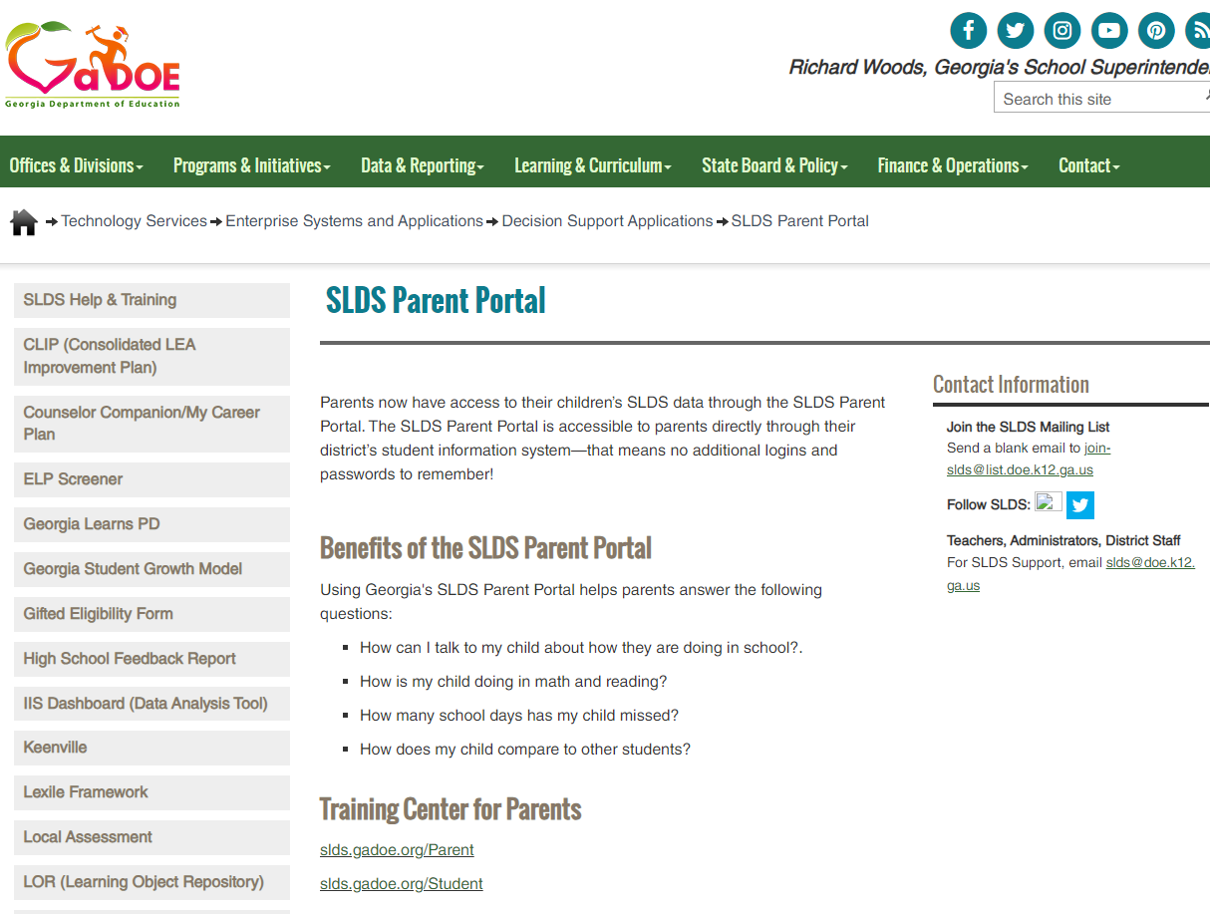
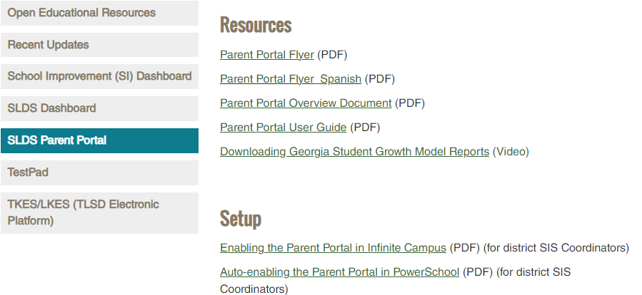
How to access previous test performance, standards, and attendance?
How to access previous test performance, standards, and attendance about my child using the Statewide Longitudinal Data System (SLDS) through the school’s parent portal.

Slide 21
Our School has a
Title-I School-Wide Program
A School-Wide program uses Title I funds to develop and maintain quality educational services in the core academic areas in order to raise academic achievement for all students at the school.

Slide 22
How is Title I Parent Engagement Money Spent?
Funding
of federal funds are allocated for parent involvement
1%
Instructional and academic resources for Parent Resource Center/Section
Instructional Resources for student support
Parent and Family Engagement Workshops and activities
Light Refreshments for Parent Workshops and activities

Slide 23
What is Required by law for Parent and Family Engagement?
District’s Parent and Family Engagement Policy
  The District’s Parent Involvement Policy-Establishes the district’s expectations for parental involvement and guides the strategies and resources that strengthen district and parent partnerships.
School’s Parent and Family Engagement Policy
  The School’s Parent Involvement Policy-Establishes the school’s expectations for parental involvement and guides the strategies and resources that strengthen school and parent partnerships.
  School-Parent Compact
  An agreement that parents, students, and teachers develop together. It explains how parents and teachers will work together to make sure all students receive the individual support they need to reach and exceed grade level academic standards.

Slide 24

Does my child’s teacher meet Professional Qualifications?
Parents Right To Know
  Parents' Right to Know Under ESEA-a parent has the right to know the following information:
  ◦The qualifications of the school staff providing instruction to their child.
  ◦Their child's level of achievement in each state academic assessment.
  ◦Whether their child has been assigned to or has been taught for four or more consecutive weeks by a teacher of a core academic subject who is not highly qualified.

Slide 25

Parents!!!!!!!
WE NEED YOU!!!!!

Slide 26
What is Parent and Family Engagement?
Parent and Family Engagement is the participation of parents in a regular, two-way, and meaningful communication involving student academic learning and school activities. Parent and Family Engagement is a requirement of the Title I program. We welcome and encourage all parents and families to be actively involved in our school.

Slide 27
Title I Parent And Family Engagement
Purpose
To improve student achievement in reading, ELA, Math, Science & Social Studies
by providing parents and family members the resources needed to support their child’s education.

Slide 28
Title I Parent and Family Engagement Activities
Annual Parent Orientation Meeting: August 17, 2023
Parent-Teacher Conferences: September 15, 2023
Family Math Night: September 26, 2023
Parent-Teacher Conferences: February 2, 2024
Family Literacy Night: February 15, 2024
Annual Stakeholder Input Meeting: March 14, 2024

Slide 29
Parent Connect
Visit our Parent Connect Canvas Page to receive various tools and resources to help support your child's learning.
An informed, engaged, and supportive family plays an instrumental role in a student's academic success. The Newton County School Systems supports families in partnerships with schools, district, and the community in the quest of achieving academic success for all students. It is our hope that this page will provide valuable information and resources to engage you as an active partner. Visit our Parent Connect Canvas Page to receive various tools and resources to help support your child's learning.
https://newton.instructure.com/courses/98226

Slide 30
Volunteer
Opportunities
PTO
Fall Festival
Holiday Shop
Spring Event
Field Day
Snow Cones Sales
Book Fairs
Jump Rope for Heart

Slide 31
Parent Decision Making Opportunities
1. Parent/Stakeholders Input Meetings
  Primary
  Secondary
2. Parent Conferences
3. Classroom Observations
4. Parent Feedback on meeting evaluations
5. Annual Parent and Family Engagement Survey

Slide 32
Parent and Students Information Handbooks
Let’s Take A Look at our School’s Handbook.
Title I Brochure
District’s Parent and Family Engagement
School’s Parent and Family Engagement Policy
School-Parent Compact
Parent Resource Room Information
Parent Conference Tips/Handout
Parent’s Right to Know Letter
Complaint Procedures
Fraud, Waste, Abuse, and Corruption Policy
Occupational Survey
Homeless Brochure

Slide 33
WASTE, FRAUD, ABUSE AND CORRUPTION Policy
This policy describes the acts of suspicious waste, fraud, abuse and/or corruption activity. The Newton County Office of Federal Programs ensures employees, clients (parents, students, etc.) and providers of confidential channels to report any said activities.
All reports of suspicious waste, fraud, abuse and/or corruption activity will be handled under the strictest confidentiality. Only those directly involved in the investigation will be given information. Informants may remain anonymous but will be encouraged to cooperate with the investigators and provide as much detail and evidence of alleged fraudulent act as possible.

Slide 34
COMPLAINT PROCEDURES
Any individual, organization or agency (“complaint”) may file a complaint with the Newton County School System (NCSS) if that individual, organization or agency believes and alleges that the NCSS is violating a Federal statute or regulation. The complaint must allege a violation that occurred not more than one (1) year prior to the date that the complaint is received, unless a longer period is reasonable because the violation is considered systemic or ongoing.

Slide 35
Copyright Piracy
Parents, as a reminder, Copyright infringement is the use of works protected by copyright law without permission, infringing certain exclusive rights granted to the copyright holder, such as the right to reproduce, distribute, display or perform the protected work, or to make derivative works.
Piracy or Intellectual Property refers to the ownership rights of materials, created, written, designed or expressed by individuals. These materials include music, games, movies, photos, and writing. Illegally downloading or sharing intellectual property without the permission of the creator is a crime punishable by law.
http://www.copyrightkids.org/

Slide 36
Responding To Parents
We value our students and parents. It is our desire to provide prompt attention to any concerns and questions you may have. Your input and feedback is appreciated at all times. Feel free to contact us at any time.

Slide 37
School-Contact Information
Stephanie Valdivia, Title l Parent Contact
valdivia.stephanie@newton.k12.ga.us
770-385-6906

Slide 38
District-Contact Information
Dr. Andrea Kinney
Director of Federal Programs
770-787-1330 extension 1248
kinney.andrea@newton.k12.ga.us
Wanda McKnight
Family Engagement and Compliance Specialist
770-787-1330 extension 1318
mcknight.wanda@newton.k12.ga.us

